Slide 1
Data Manager Overview

Slide 2
We currently have 5 data managers:
1. HIV Surveillance Manager
This is for JHEEM, commonly called “Surveillance Manager”
Typically MSA level data
2. Census Manager
This contains general population level data (births, deaths, etc.). We pull cached data from it for other data managers but avoid running it frequently because it’s so large.
Typically County level data
3. Syphilis Surveillance Manager
This is for SHIELD, Parastu calls this the ‘Surveillance Manager’
Typically MSA level data
4. Ryan White Data Manager
5. Ryan White Web Tool Manager

Slide 3
In order to ‘put’ data into the data manager, it must have:
Year – what year does the data point represent?
Location- what location does the data point represent? (county, state, MSA, national)
Outcome- what is the data point? Ex. Diagnoses, population, prevalence, etc.
Value- the actual data point
Source- where did the data come from? Note each source has a parent source.
Ontology- what is the categorical structure of the data?
URL- where can you access this data online?
Details- any relevant info
Optional: stratifications

Slide 4
Stratifications
We stratify data different ways:
Sex (male, female)
Age
Note JHEEM uses 13+ (this is why we have adult.population and adult.immigration)
Age groups are commonly recategorized using ‘restratify.age.counts’
Race (varies by ontology)
Race can be ‘redistributed’ within put.long.form using ‘dimension.values.to.distribute’
Typically do this for multiracial and unknown
Risk (msm, msm_idu, heterosexual, other)

Slide 5
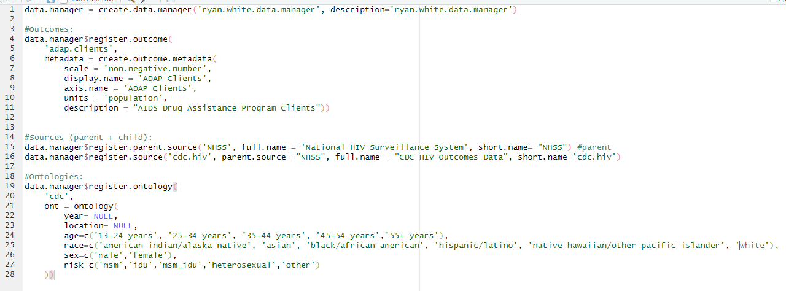
To Create a Data Manager..
Register outcomes, sources, and ontologies
Ontologies use lowercase

Slide 6
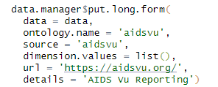
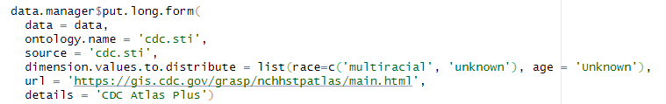
Put.long.form
Data is pulled, cleaned/processed, and then put into the data manager
Certain values can be ‘resdistributed’ within the put.long.form

Slide 7
Common Problems for put.long.form
Invalid locations
DC and PR
Counties that have changed over time

Slide 8
The Locations Package
Locations have to be in a specific format in order to be ‘put’ into the data managers:
States use two letter abbreviations
Counties use 5 digit codes (the first two numbers are the state FIPS codes)
MSAs use “C.12345”
National level data is just “US”
Two codes that establish locations vectors we typically use:
Commoncode/locations_of_interest
Commoncode/additional_locations_of_interest
Jeff Pennington created/manages the locations package

Slide 9
Commonly Used Functions

Slide 10
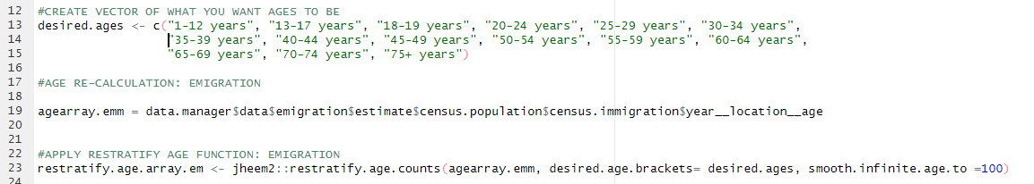
Restratify.age.counts
This is a function that Todd wrote to change age groupings presented in the data to meet the needs of the model
Example: immigration_age_calculations_new.R

Slide 11
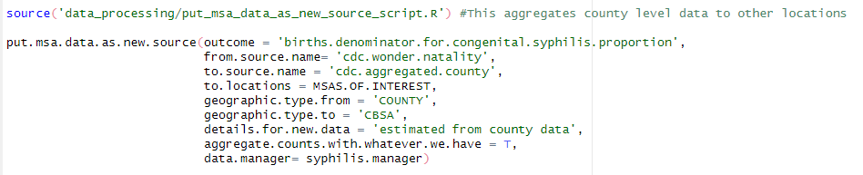
Put.msa.as.new.source
This is a code Andrew wrote to aggregate outcomes from one geography to another (typically county to MSA)
The default is that this will not aggregate if any single location is missing
That can be overwritten with ‘aggregate.counts.with.whatever.we.have’

Slide 12
After Adding Data

Slide 13
Merging Process
Data Managers are broken into different sections to make it faster to run changes
Data_processing -> syphilis.manager
This is where all of the data cleaning codes are for the syphilis manager
Data_processing -> syphilis.manager -> syphilis.processing.for.merging
Contains the codes to create the different sections and merge

Slide 14
Sync cached data manager
This is a code Andrew wrote that allows folks to automatically download the newest version of a particular data manager.
source('commoncode/cache_manager.R’)
Push the rdata object to update the metadata
URL has to be updated each time
cached

Slide 15
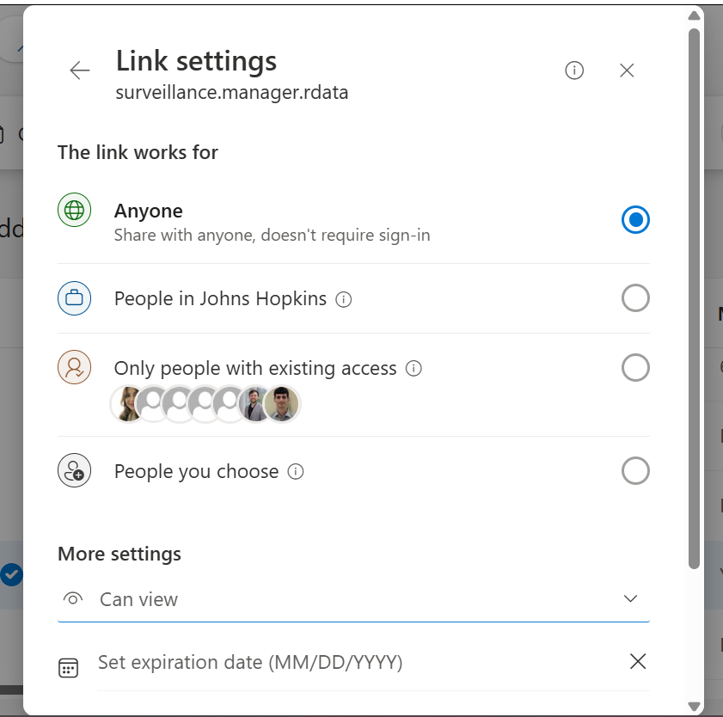
Sync cached data manager
To copy the link, change two settings:
1. Change to ‘anyone’
2. Change to ‘can view’

Slide 16
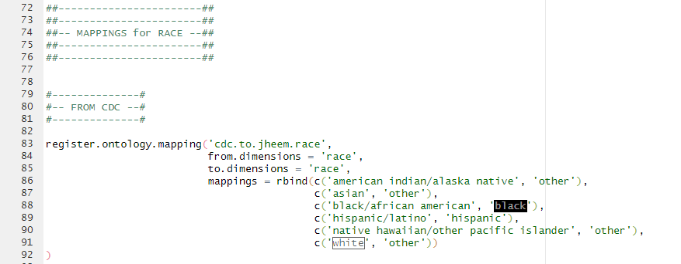
Ontology Mappings
How can we connect the data structure to the structures used for the model?
JHEEM: jheem_analyses -> applications -> EHE -> ehe_ontology_mappings.R
SHIELD: jheem_analyses -> applications -> SHIELD -> shield_ontology_mappings.R

Slide 17
Data

Slide 18
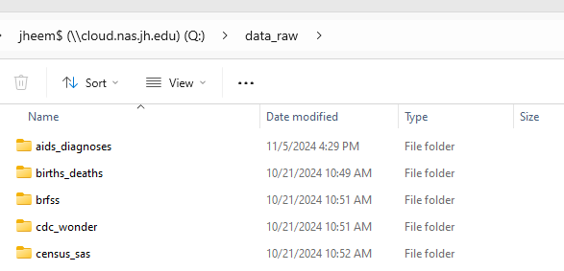
Common Data Sources
Census
Population data, deaths, migration
Atlas Plus
A CDC data query system, contains HIV/STI data as well as social determinants of health
CDC Wonder
Another CDC data query system, contains births, deaths, AIDS data
We store raw data on the Q drive.

Slide 19
Pulling data from PDFs
Tabula
Java needs frequent re-installation

Slide 20
Documentation

Slide 21
Documentation
SHIELD Documentation kept in the SHIELD Shared folder:
Data Manager Documentation -> ‘Syphilis Manager Data Overview_MMDDYY’
I archive old versions
Currently working on finalizing documentation for HIV/Census managers
SHIELD-Shared

Slide 22
Data Manager History
I keep a word doc of why we did certain things over time

Slide 23
Other Helpful Things

Slide 24
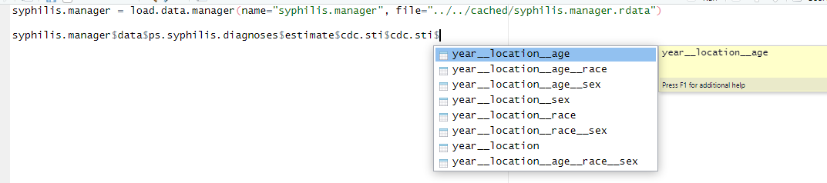
Pulling Data
There’s two ways to pull data from an existing data manager:
$ method
Pull function

Slide 25
Accessing Data in the Data Manager
To see all data for an outcome/source/ontology:
To see a specific location/year/stratification:
Note: if the source includes ‘aggregated’ it’s an indication that we aggregated the location from a smaller to larger geography/

Slide 26
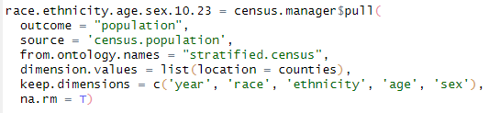
Using the Pull Function
Code:

Slide 27
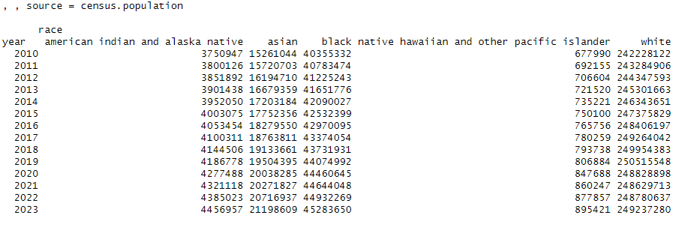
Using the Pull Function
Output:

Slide 28
Outlier Code
Data_processing -> outlier_finder.R
Andrew wrote a code that identifies and removes outliers based on several criteria.
The function gives you a data frame of possible outliers, you decide how to reconcile, then return a data frame with the decisions.
Arguments include:
Phi (a percent change from one year to another that does not depend on how many years apart the data points are from)
Theta (a multiplier that produces a percent change based on how many years apart two samples are)
Max year (outliers will not be identified after this year)
First.choice.year (this year will be defined as the reference point for the outliers)
Important to consider year choices in the context of COVID data.

Slide 29
Outlier Code
Data_processing -> outliers
In the folder above, there are 3 separate codes that remove outliers. The first is total level, the one way, then two way.
If an outlier is removed at the total level, data is also removed for any stratifications.
If you add data to an outcome included in the outliers code, you may have to reassess for additional outliers.

